Slide 1
RevShop
Secure Console-Based E-Commerce Platform
Presented by: Vamsi Ujwal
Technology: Java + Oracle XE

Slide 2
Introduction
RevShop is a secure console-based e-commerce application.
It connects buyers and sellers on one platform.
Users can browse, buy, sell, and manage products.

Slide 3
Problem Statement
Small-scale sellers lack digital platforms.
Many console apps lack security and proper cart systems.
RevShop provides a structured and secure solution.

Slide 4
Objectives
• Secure login system
• Buyer and Seller modules
• Inventory management
• Payment simulation
• Review and rating system

Slide 5
Technical Stack
Programming Language: Java
Database: Oracle XE
Connectivity: JDBC
Version Control: Git
Logging: Log4J

Slide 6
Buyer Module
• Register / Login
• Browse products
• Add to cart
• Place order
• View order history
• Rate and review products

Slide 7
Seller Module
• Register with business details
• Add / Update / Delete products
• Set discounts and MRP
• View orders
• Monitor stock levels

Slide 8
Database Design
Main Tables:
APP_USERS, BUYERS, SELLERS,
PRODUCTS, CATEGORIES,
CARTS, ORDERS, REVIEWS, WISHLIST
Triggers used for auto ID generation.

Slide 9
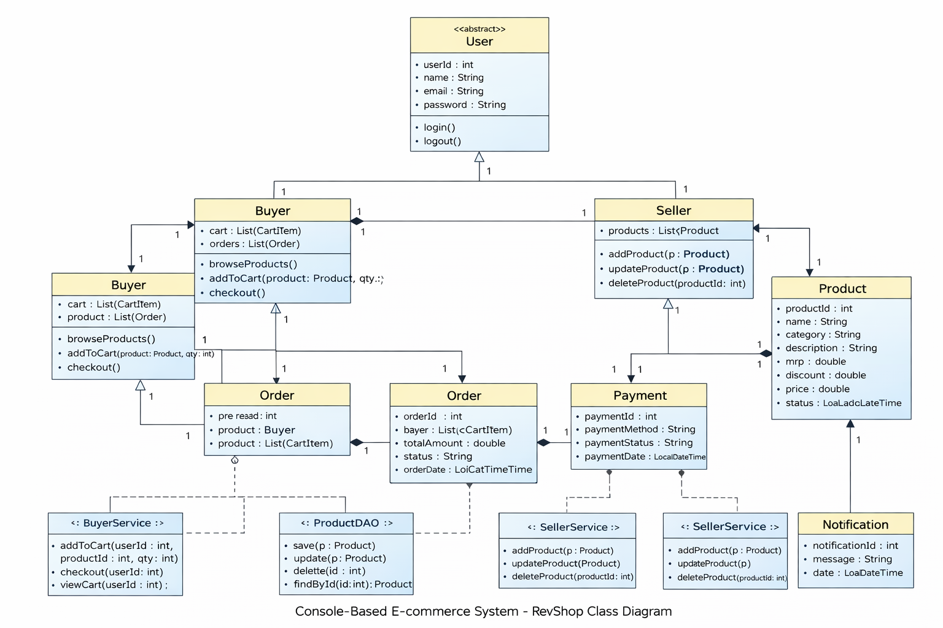
Class Diagram

Slide 10
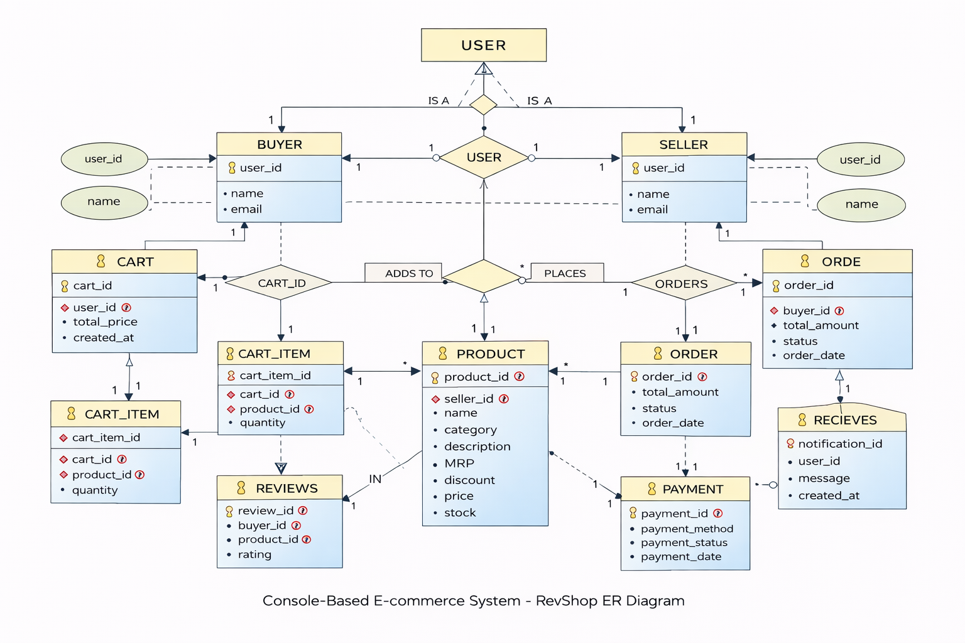
ER- Diagram

Slide 11
Security Features
• Role-based authentication
• Password validation
• Input validation
• Controlled module access

Slide 12
Future Enhancements
• Convert to Web Application (Spring Boot)
• Real payment gateway integration
• Recommendation system
• Cloud deployment

